Slide 1


Java Fx
Phạm Xuân Trí – 18521530
Lưu Hoàng Sơn - 18521348

Slide 2
Table of contents
01
03
05
02
04
06
Introduction
Concepts
Disadvantage
Introduction about JavaFX. What is JavaFX?
List utility features of JavaFX. Demos of some
List of limitation of JavaFX
Importance
Demo
Reference
Why was it born?
Demo Pokemon apps
List of reference

Slide 3
01
Introduction

Slide 4




What is JavaFX ?
“JavaFX is an open source, next generation client application platform for desktop, mobile and embedded systems built on Java”
Game
Desktop application
Mobile application
Notes:
JavaFX is a GUI toolkit for Java (GUI is short for Graphical User Interface). JavaFX makes it easier to create desktop applications and games in Java.

Slide 5
History
Initially this project was named as F3 (Form Follows Functions)
In 2007, JavaFX was public at Java One conference
In 2021, Sun Microsystems have just released version 16
In 2005, Sun Microsystems rename F3 as JavaFX
In 2008, Net Beans integrated with JavaFX was available

Slide 6
02
Importance

Slide 7
JavaFX vs. Swing
JFX | Swing
Standard GUI library, having extensive support. | Toolkit for the GUI widget

Slide 8



Why you need to Java FX?
Great
RIA
Diversity
Solve the limitations of Swing
Able to build Rich Internet Applications(RIA)
A rich set of GUI controls

Slide 9
Main concepts’ difference

Slide 10
Main concepts’ difference

Slide 11
Main concepts’ difference

Slide 12
Main concepts’ difference

Slide 13
Main concepts’ difference

Slide 14
Main concepts’ difference

Slide 15
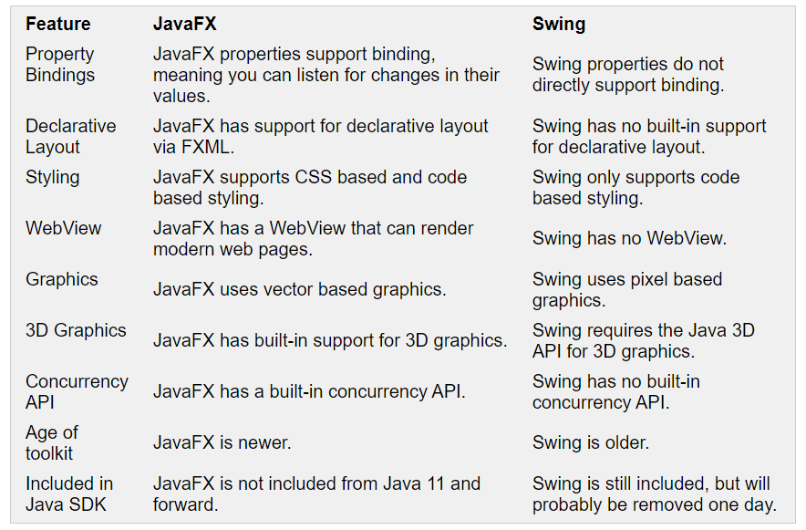
Features’ difference

Slide 16
Why should we use JFX ?
Separated View / Controller using FXML to create visual ⇒ Easy to change GUI without any impact on controller ⇒ Easy for debugging and maintainance.
Controllers is easily intergrated with view.
Easy to responsive using declarative layout.
CSS supportive.
Strongly working flow.

Slide 17
03
Concepts

Slide 18
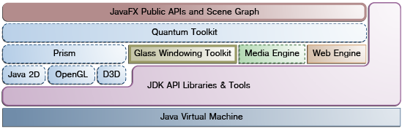
Architecture

Slide 19
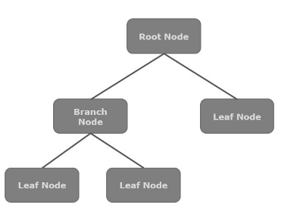
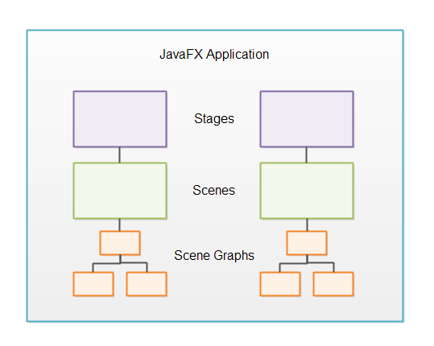
Architecture
Scene Graph
Notes:
A node instance can be added to a scene graph only once. The nodes of a scene graph can have Effects, Opacity, Transforms, Event Handlers, Event Handlers, Application Specific States.

Slide 20
Architecture
Scene Graph
A node is a visual/graphical:
Geometrical: Circle, Rectangle, Polygon, etc.
UI controls: Button, Checkbox, Choice box, Text Area, etc.
Layout: Border Pane, Grid Pane, Flow Pane, etc.
Media elements: Audio, video and image objects.

Slide 21
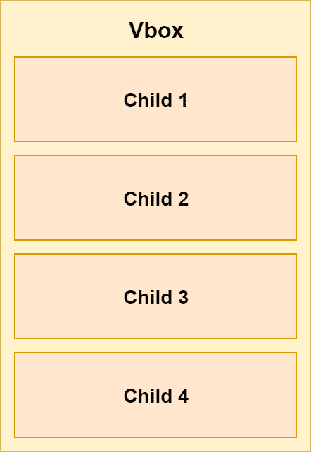
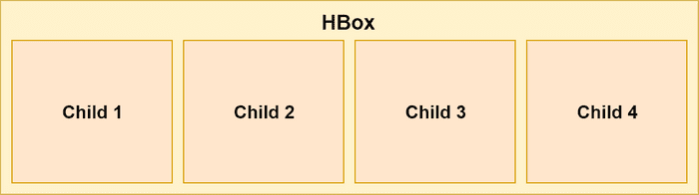
Demo layouts

Slide 22
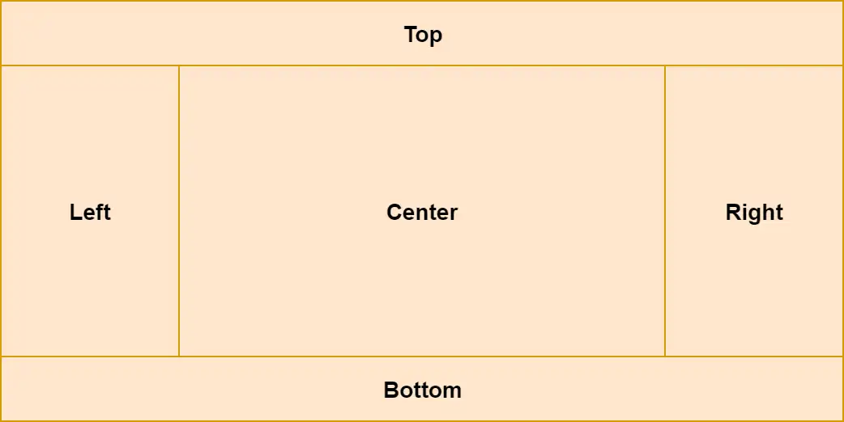
Demo layouts

Slide 23
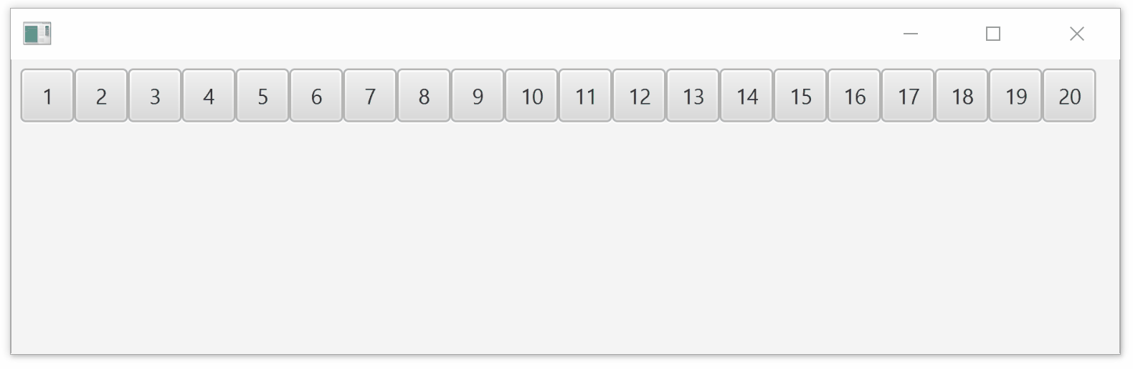
Demo layouts

Slide 24
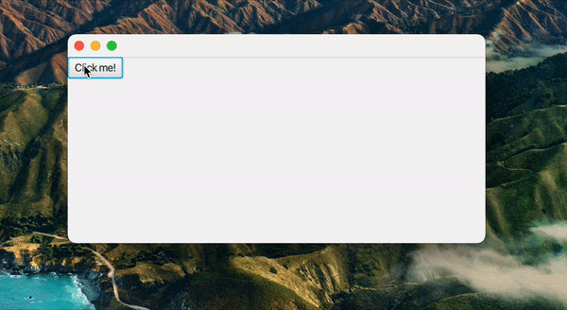
Coding Style

Slide 25
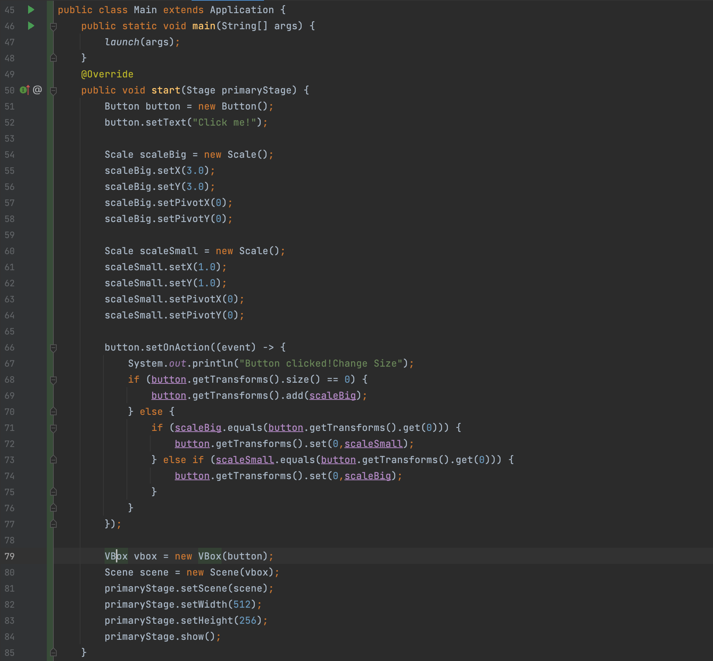
Coding Style
Code-Based

Slide 26
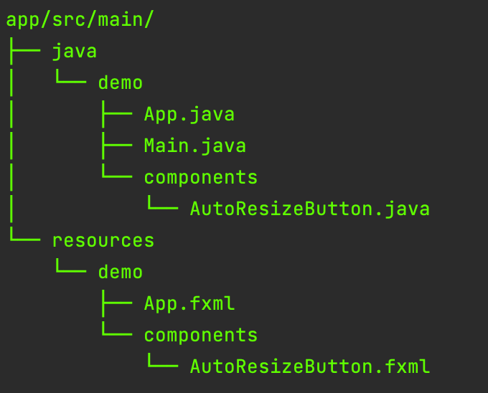
Recommended project structure

Slide 27
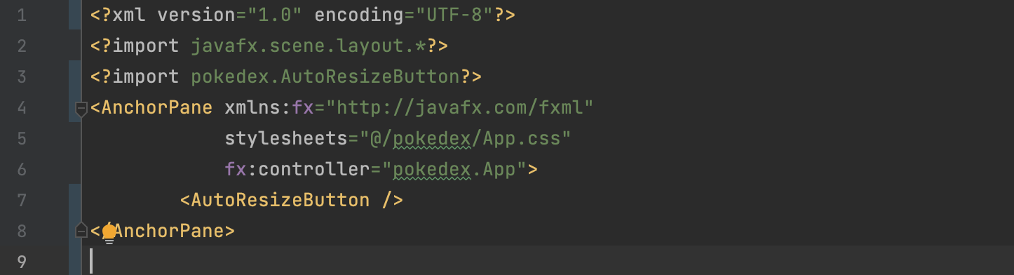
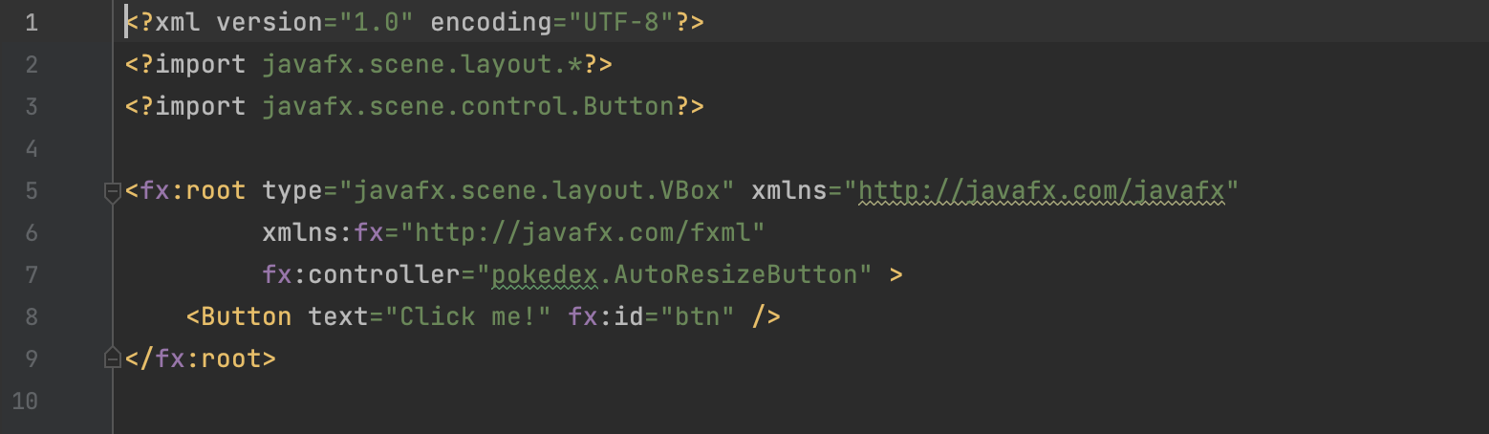
Recommended project structure
App.fxml
AutoResize
Button.fxml

Slide 28
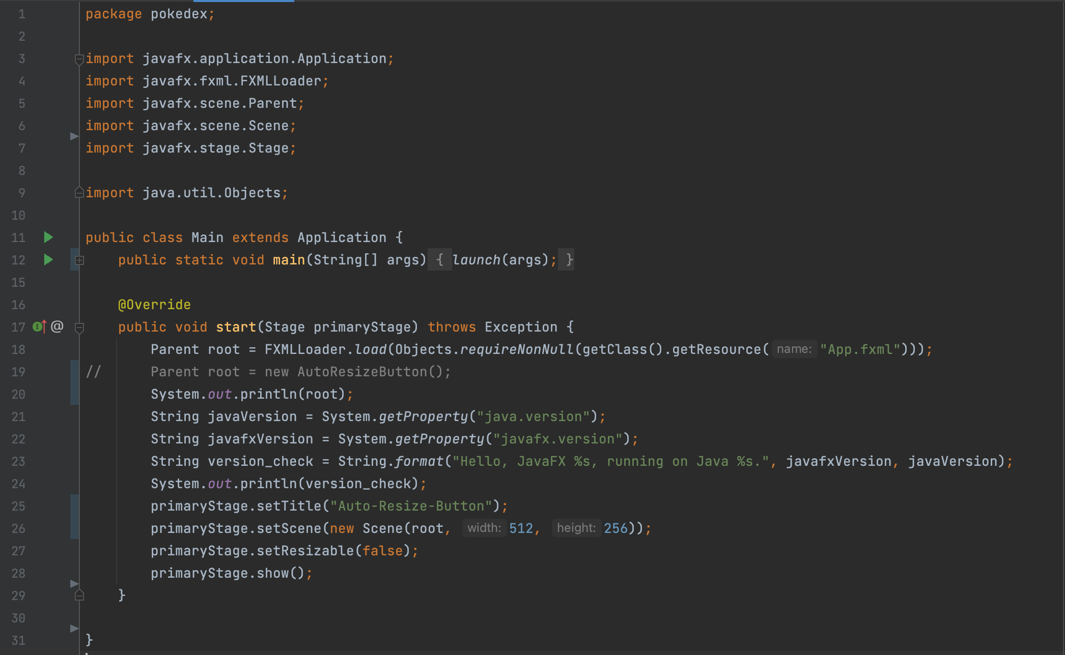
Recommended project structure
Main.java

Slide 29
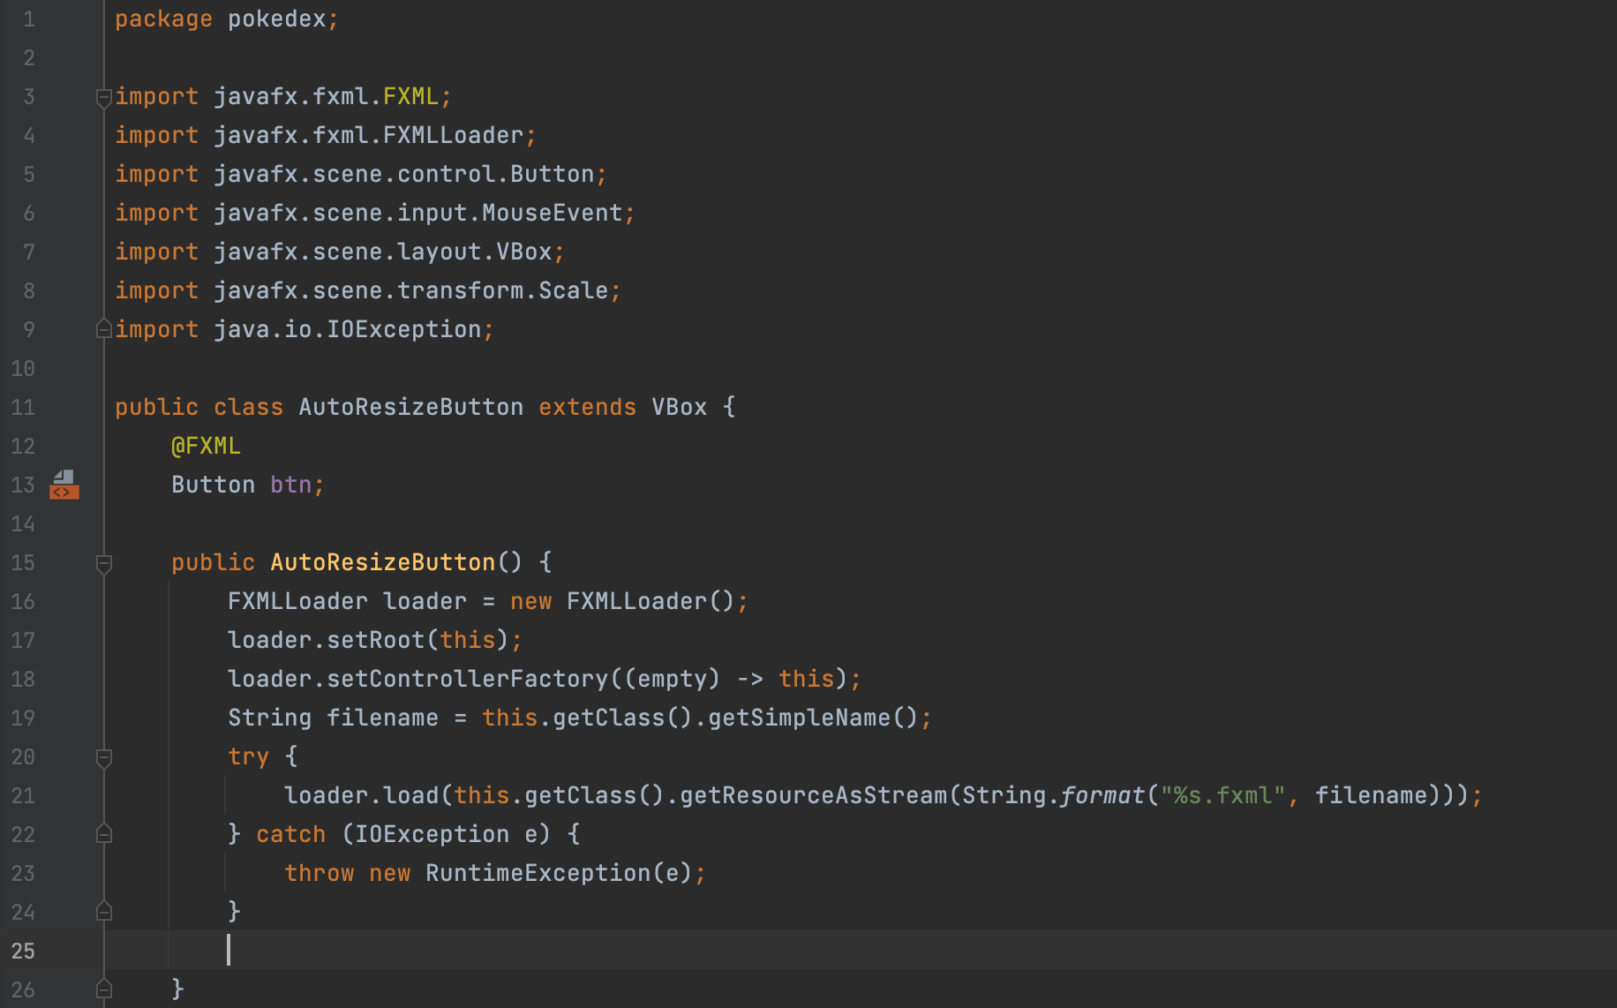
Recommended project structure
AutoResize
Button.java

Slide 30
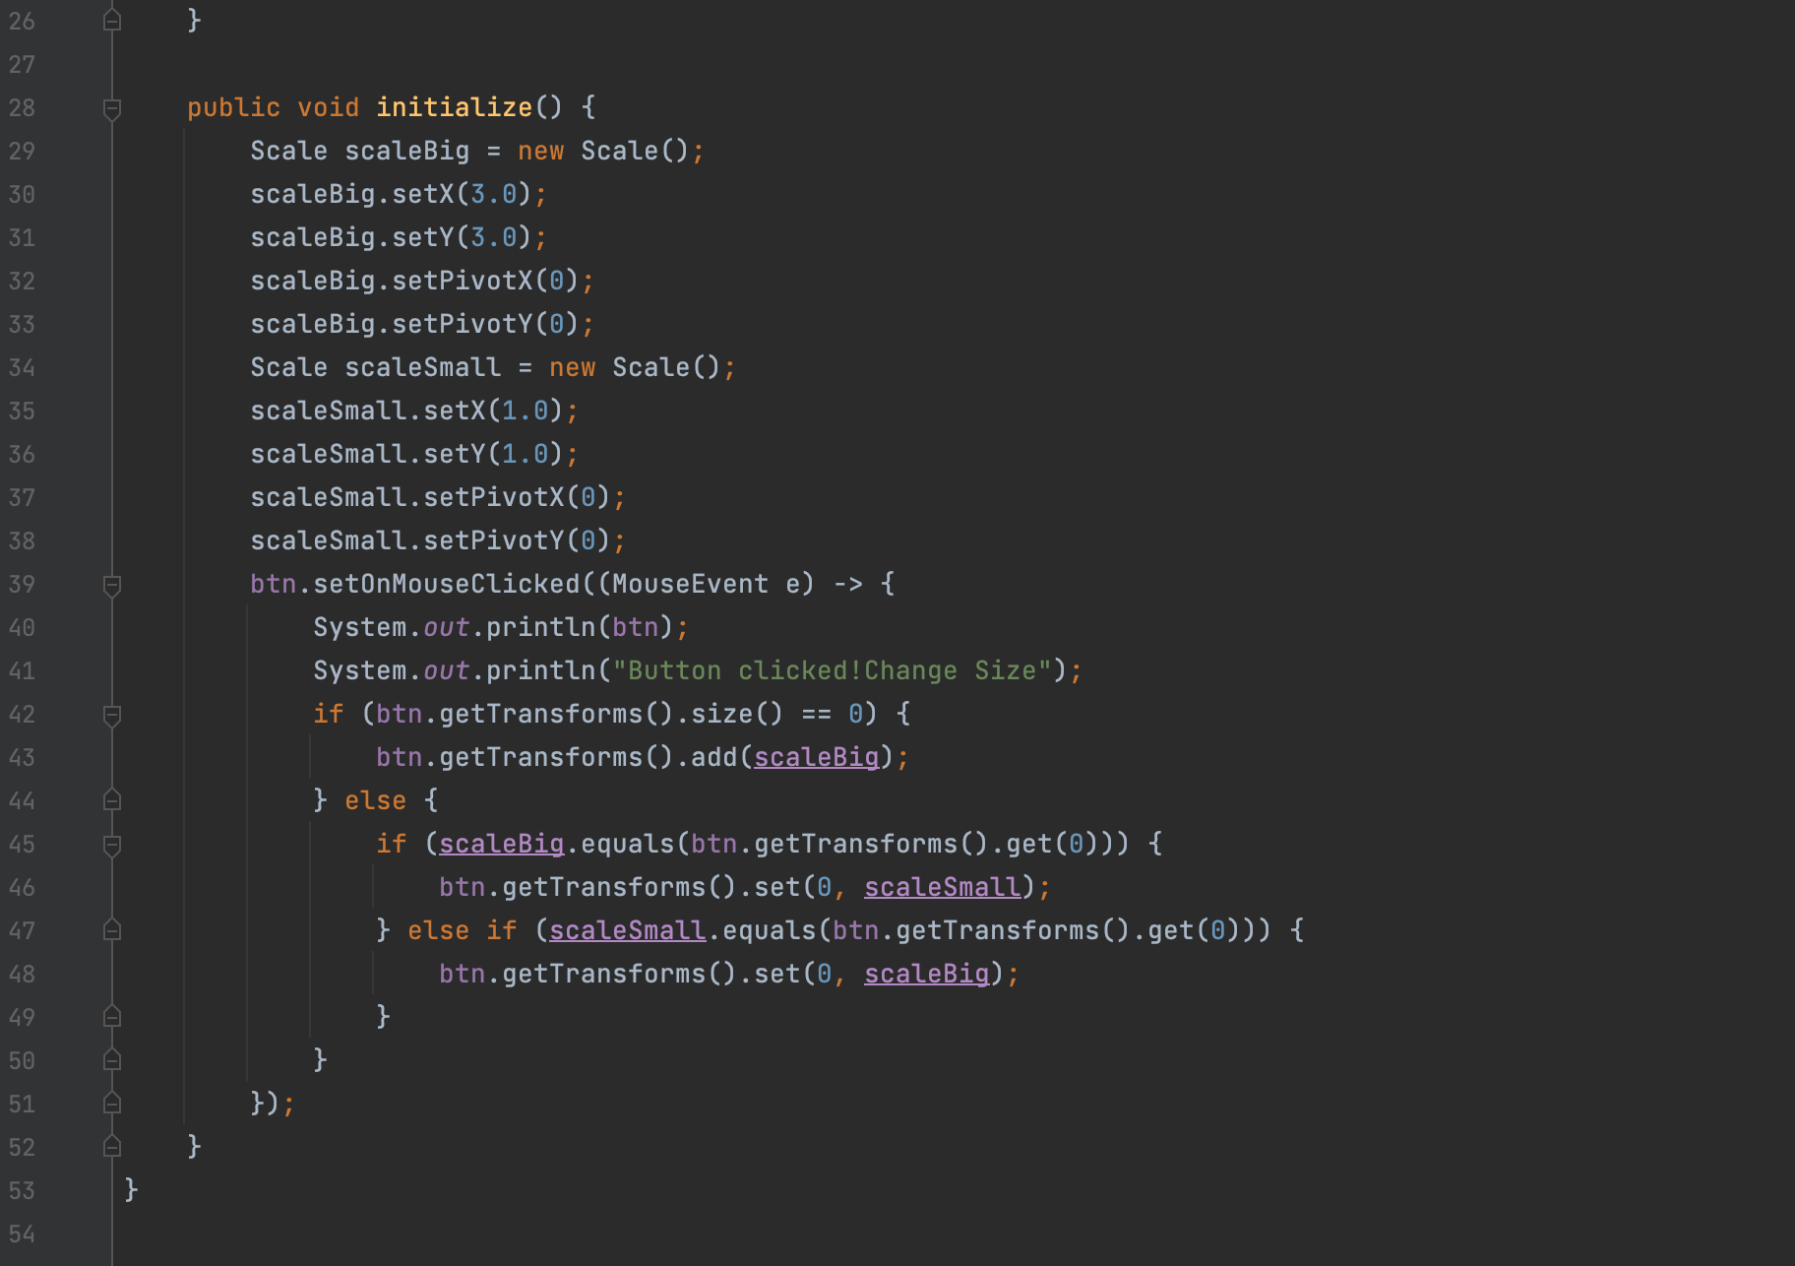
Recommended project structure
AutoResize
Button.java

Slide 31
04
Demo
Menu

Slide 32
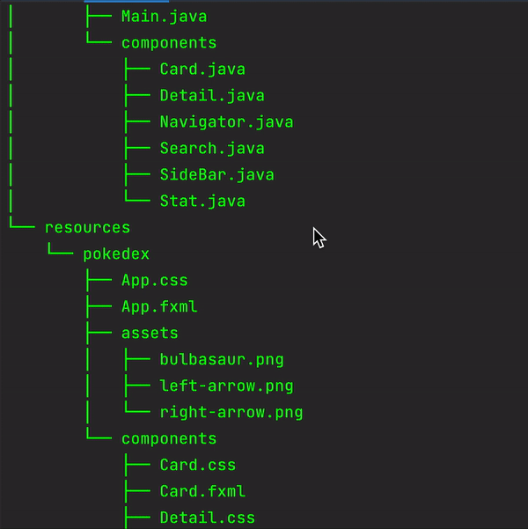
Project Structure

Slide 33
Pokedex demonstration
Live: Demo with Source code – Overview explained
Demo Video: https://youtu.be/2eX27xVOASw
Source Code: https://github.com/sonlhcsuit/pokedex-jfx

Slide 34
05
Disadvantage

Slide 35
Disadvantage
Not quite as mature in terms of getting all the bugs out
Hard to debug in terms of FXML file
No longer supportive in JDK, must be installed as third-party library
Lack of number of components
CSS integration not easy to use
Hard to start

Slide 36
06
Reference
Menu

Slide 37
References
http://tutorials.jenkov.com/javafx/index.html
https://www.tutorialspoint.com/javafx/index.html
https://openjfx.io/javadoc/16/
https://docs.oracle.com/javase/8/javafx/api/toc.htm
https://github.com/sonlhcsuit/pokedex-jfx.git
Notes:
JavaFX is a GUI toolkit for Java (GUI is short for Graphical User Interface). JavaFX makes it easier to create desktop applications and games in Java.

Slide 38
Thanks

